Slide 1
CHAPTER 8
Loops

Slide 2
Last chapter we learned about sequence structures and selections structures.
Loops are a category of structure known as iteration structures. Each time it loops through code, it is performing an iteration.
Three types of iteration structures in C++:
for loop
while loop
do while loop

Slide 3
for Loop
Repeats a statement a specified number of times.
This amount to specify how many times its repeated is called a parameter.
Just like a if test, a for loop has parenthesis after it to specify the parameter, as well as brackets around the code it loops.
Ex.
for (i = 1; i <= 3; i++)
//for(control expression; initializing expression; step expression)
First parameter is the initializing expression. This is set to the value you want to begin your loop at.
Second parameter is the control expression. As long as this expression is true, the loop iterates.
The last parameter is the step expression. This increments the counting variable.

Slide 4
*notice how int i declares i, saving you from declaring it earlier.
Example code:
#include <iostream>
main()
{
for(int i = 100; i >= 0; i = i – 10)
{
cout << “Test score:” << i << endl;
}
cout << “End of Loop”<<endl;
return 0;
}
This will output:
Test score: 100
Test score: 90
Test score: 80
Test score: 70
Test score: 60
Test score: 50
Test score: 40
Test score: 30
Test score: 20
Test score: 10
Test score: 0
End of Loop

Slide 5
while Loop
Something within the while loop causes the iteration to stop.
The loop repeats as long as its control expression in true.
The control expression can be any true statement. In a while loop, it is located in the beginning.
If you were to write a statement to divide a number by 2 until it is less than or equal to 1, you could use a while loop.
Example on next page

Slide 6
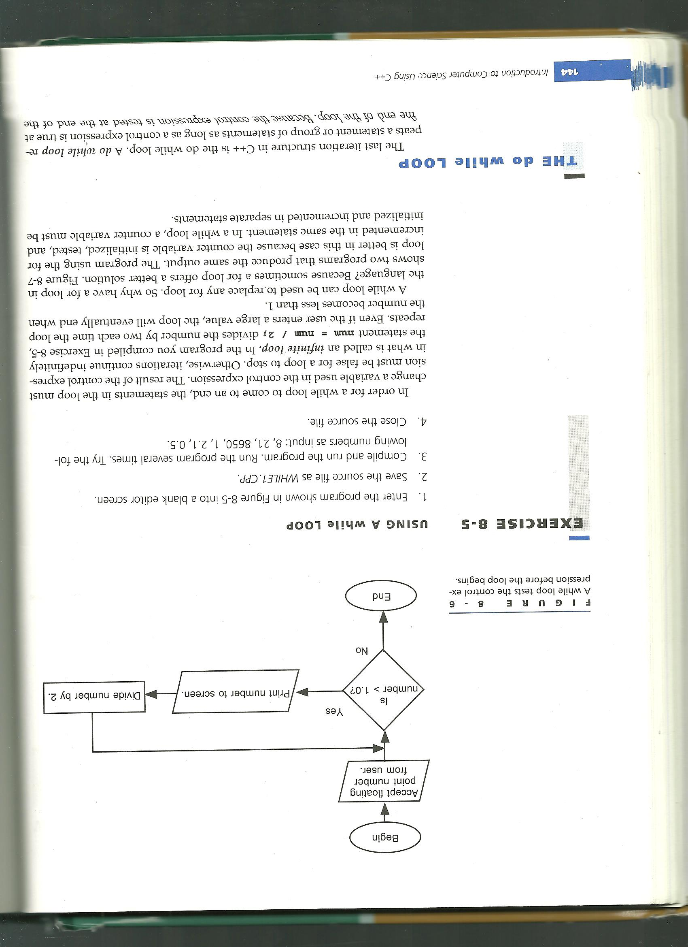
#include
int main()
{
float num;
cout << “Enter number to divide:”;
cin >> num;
while (num > 1.0)
{
cout << num << endl;
num = num / 2;
}
return 0;
}
Note: Make sure it is possible for the control expression to equal false by iterating the loop. Or else, you will have achieved the INFINTE LOOP! p.s. don’t do this.

Slide 7
do while Loop
This loop contains the control expression at the end of the expression, compared to it being at the beginning in a while loop.
This means the statement will be executed at least one time before the control expression is tested.
Ex.
do
{
cout << enter a number( Enter 0 to quit):”
cin >> num;
squared = num * num;
cout << num << “squared =” << squared<< endl;
}
while (num != 0);

Slide 8
The break keyword used in switch functions works with loop as well.
It immediately ends the loop.
Ex.
do
{
cout << enter a number( Enter 0 to quit):”
cin >> num;
if (num == 0)
{break;}
squared = num * num;
cout << num << “squared =” << squared<< endl;
}
while (1);

Slide 9
The continue keyword is used to skip the rest of an iteration, and start the next iteration of a loop.
Ex.
for(i = 1; i<=10; i++)
{
if (i == 5)
continue;
cout << i << endl;
}
This will output:
1
2
3
4
6
7
8
9
10

Slide 10
A nested loop is a loop within a loop.
Ex.
#include <iostream>
int main()
{
int i,j;
cout << “begin”
for (i=1; i <=3; i++)
{
cout << “Outer loop: i =“ << i << endl;
for (j=1; j <=4; j++)
cout << “ Inner Loop: j =“ << j << endl;
}
cout << “end”
return 0;
}

Slide 11
Many modern operating systems are event driven, so they repeatedly iterate an event loop until an event such as a mouse click or key press occurs.
Key terms:
control expression
do while loop
event driven
event loop
for loop
infinite loop
initializing expression
iteration
iteration structures
loop
nested loop
parameter
step expression
while loop

